Slide 1







IBM Data Analyst Capstone Project
Cludette Henningham
June 24, 2024

Slide 2



OUTLINE
Executive Summary
Introduction
Methodology
Results
Visualization – Charts
Dashboard
Discussion
Findings & Implications
Conclusion

Slide 3

EXECUTIVE SUMMARY
Analysis of patterns in usage of languages and databases over a period of time
Assessing the demand for Technology jobs over a period of time

Slide 4

INTRODUCTION
An analysis of language and database usage over a period of time. This involved reviewing :
Future Trends in programming languages and databases
Demographics Survey
Technology

Slide 5

METHODOLOGY
Data collection using Web API, Excel
Data exploration
Data Cleaning/normalization
Data visualization using bar charts, pie charts, heat map

Slide 6
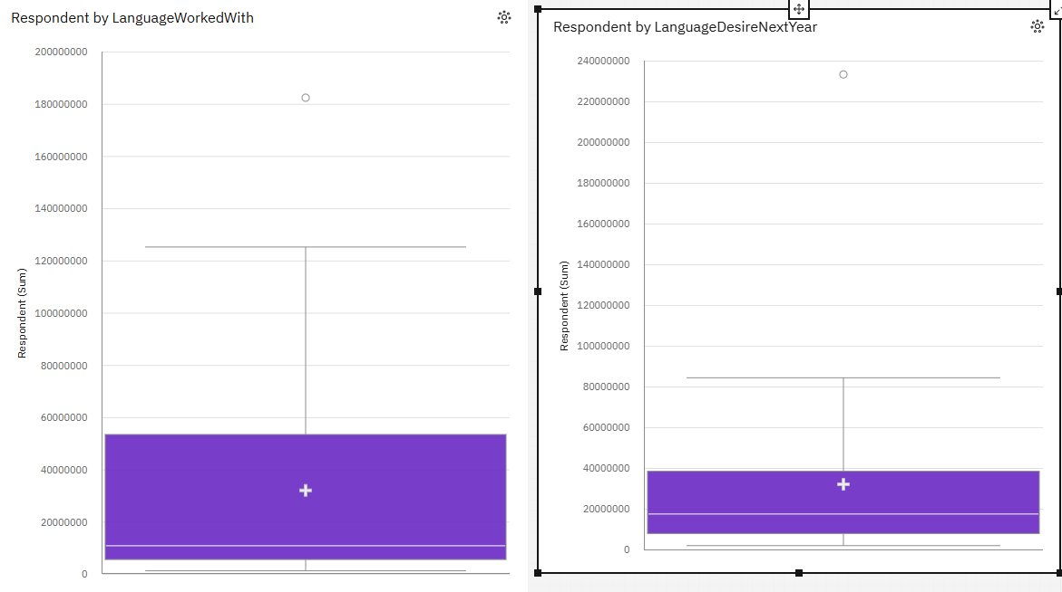
RESULTS
The box plots of language being worked with and language desired in the future show a significant decrease in future demand for languages

Slide 7
PROGRAMMING LANGUAGE TRENDS
Current Year
Next Year
JavaScript (17.5 %), HTML/CSS (15.8 %), and SQL (14.3 %) are the most frequently occurring categories of LanguageWorkedWith with a combined count of 23,623 items with LanguageWorkedWith values (47.5 % of the total).
The total number of results for LanguageWorkedWith, across all LanguageWorkedWith, is nearly 50 thousand.
Bash/Shell/PowerShell is the most frequently occurring category of LanguageDesireNextYear with a count of 258 items with LanguageDesireNextYear values (20.9 % of the total).
The total number of results for LanguageDesireNextYear, across all LanguageDesireNextYear, is over a thousand.

Slide 8
PROGRAMMING LANGUAGE TRENDS - FINDINGS & IMPLICATIONS
Findings
Twice as many languages are used than the number of language that is required by businesses
Implications
Businesses need to make use of Machine learning to accommodate the larger number of languages that are in usage

Slide 9
DATABASE TRENDS
Current Year
Next Year
PostgreSQL (22 %), SQLite (18.8 %), Redis (18.1 %), and MySQL (13.4 %) are the most frequently occurring categories of DatabaseWorkedWith with a combined count of 952 items with DatabaseWorkedWith values (72.3 % of the total).
The total number of results for DatabaseWorkedWith, across all DatabaseWorkedWith, is almost 1500.
MongoDB (18.8 %) and Elasticsearch (16 %) are the most frequently occurring categories of DatabaseDesireNextYear with a combined count of 390 items with DatabaseDesireNextYear values (34.8 % of the total).
The total number of results for DatabaseDesireNextYear, across all DatabaseDesireNextYear, is over a thousand.

Slide 10
DATABASE TRENDS - FINDINGS & IMPLICATIONS
Findings
A declining trend in the usage of databases
Implications
Workers need to upskill to address the change in demand for database usage.
Businesses need to invest in future technology that rendering databases obsolete

Slide 11

DASHBOARD
chenningham2/JDA-Training (github.com)

Slide 12
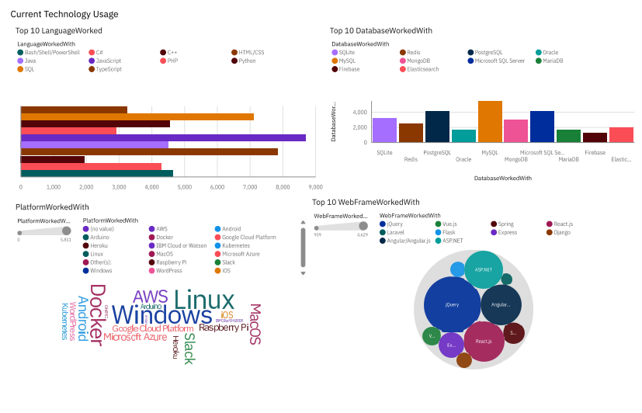
DASHBOARD TAB 1

Slide 13
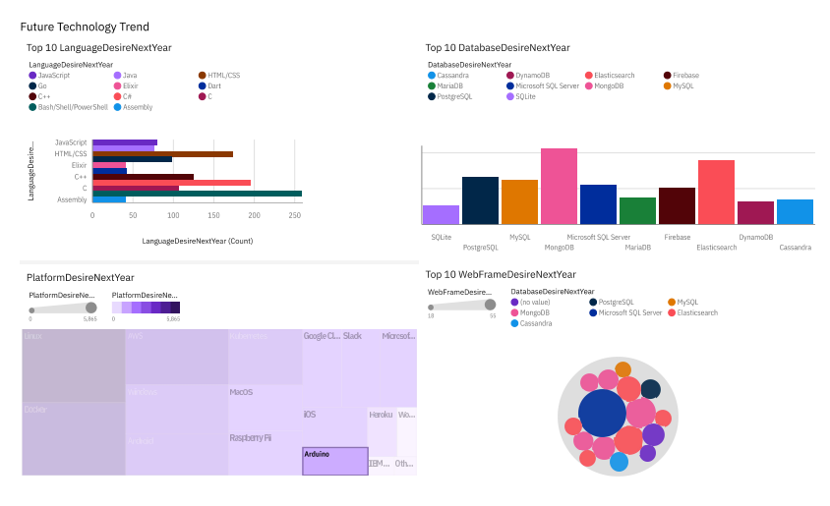
DASHBOARD TAB 2

Slide 14
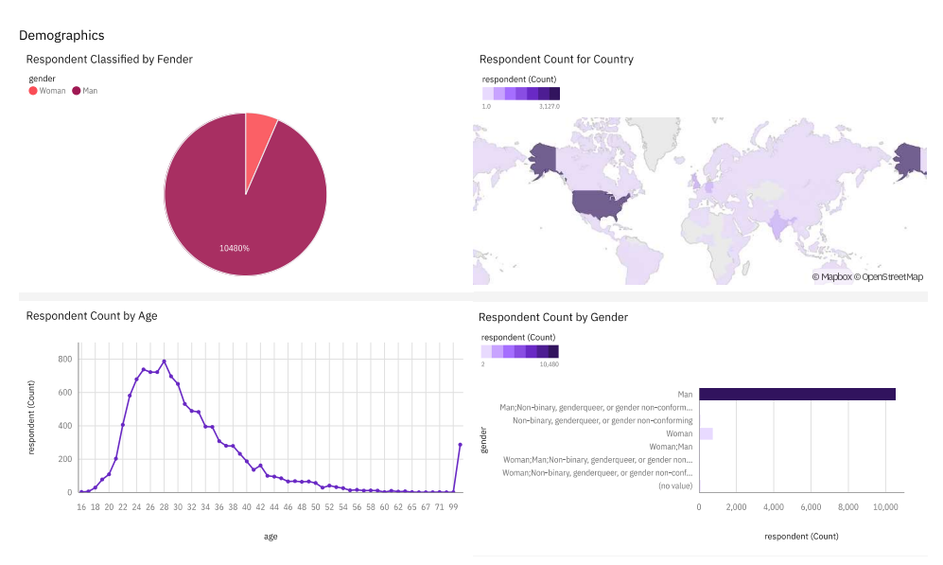
DASHBOARD TAB 3

Slide 15
DISCUSSION
Usage of technology dropped over time. This might be the result of the introduction of Artificial Intelligence.
Types and variety of languages used by developers do not reflect the needs of the businesses. The business appears to have less need for using a large variety of different languages.

Slide 16
OVERALL FINDINGS & IMPLICATIONS
Findings
Technology usage increases over time
Implications
Businesses need to make use of technology that helps them respond to changes instantaneously to be competitive

Slide 17

CONCLUSION
Comparing Technology Trends for the current and next year shows that there is a decline in demand.
Programming Languages, Database, and Platform Overview appear to be on the decline
Global Demographics review of survey respondents indicates that the decreasing trend is global

Slide 18
JOB POSTINGS
In Module 1 you have collected the job posting data using Job API in a file named “job-postings.xlsx”. Present that data using a bar chart here. Order the bar chart in the descending order of the number of job postings.

Slide 19
POPULAR LANGUAGES
In Module 1 you have collected the job postings data using web scraping in a file named “popular-languages.csv”. Present that data using a bar chart here. Order the bar chart in the descending order of salary.

